Slide 1
AWT Components & Event Handling Unit 4 & Unit 5

Slide 2
Some types of components
Button
Checkbox
Label
Choice
Scrollbar
TextField
List
TextArea
Button
Checkbox
CheckboxGroup

Slide 3
AWT -Class Hierarchy
Component
Container
Window
Frame
Button
Panel
List
Checkbox
Choice
Label
TextComponent
TextField
TextArea
Notes:
This slide shows the hierarchy of classes which will be covered in this chapter. If you check the Java API documentation, you will note that there are many more classes in the java.awt package.

Slide 4
Container
The Container is a component in AWT that can contain another components like buttons, textfields, labels etc.
The classes that extends Container class are known as container such as Frame, Dialog, Panel and Applet.

Slide 5
Creating components
Label lab = new Label ("Hi, I m Label");
Button but = new Button ("Click me!");
Checkbox toggle = new Checkbox ("toggle");
TextField txt = new TextField ("Initial text.", 20);

Slide 6
Adding components to the Applet
class MyApplet extends Applet
{
public void init ()
{ ….
add (lab); // same as this.add(lab);
add (but);
add (toggle);
add (txt);
...
}
…
}

Slide 7
Common methods of Component class
Method | Description
void add(Component c) | inserts a component on this component.
void setSize(int width,int height) | sets the size (width and height) of the component.
Dimension getSize() | Returns the current size of this component.
void setLayout(LayoutManager m) | defines the layout manager for the component.
void setVisible(boolean status) | changes the visibility of the component, by default false.
void setBackground(Color c) | Sets the background color.
void setForeground(Color c) | Sets the foreground color.
void setFont(Font f) | Sets the font of the component.

Slide 8
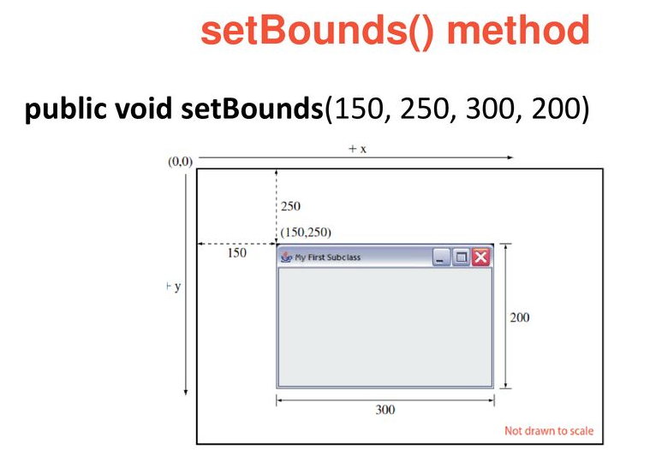
setBounds() method

Slide 9
setBounds() method
The layout managers are used to automatically decide the position and size of the components.
In the absence of a layout manager, the position and size of the components have to be set manually.
The setBounds() method is used in such a situation to set the position and size.
To specify the position and size of the components manually, the layout manager of the frame can be null.
setBounds(int x-coordinate, int y-coordinate, int width, int height)

Slide 10
Label class
This class is a Component which displays a single line of text.
Labels are read-only. That is, the user cannot click on a label to edit the text it displays.
Text can be aligned within the label
Constructors are:
Label()
Label(String label)
Label(String label, int align) Label.LEFT,Label.RIGHT, Label.CENTER (Default align is left)
Methods:
String getLabel()
void setLabel()
Ex: Label welcome = new Label(“Hi");
this.add(welcome);

Slide 11
Button class
This class represents a push-button with label.
Constructors:
Button( )
Button(String caption)
For ex:
Button okButton = new Button("Ok");
Button cancelButton = new Button("Cancel");
this.add(okButton));
this.add(cancelButton));
Example

Slide 12
Checkbox class
This class represents a GUI checkbox with a label.
The Checkbox maintains a boolean state indicating whether it is checked or not.
If a Checkbox is added to a CheckBoxGroup, it will behave like a radio button.
Constructors are:
Checkbox()
Checkbox(String label)
Checkbox(String label,boolean on)
Checkbox(String label,boolean on, CheckboxGroup gr)
Checkbox(String label, CheckboxGroup gr ,boolean on)
Methods:
String getLabel() , void setLabel()
boolean getState(), void setState(boolean state)
Ex: Checkbox cbOk = new Checkbox(“OK”,true)
this.add(cbOk)

Slide 13
Choice Class
This class represents a dropdown list of Strings.
Only one item from the list can be selected at one time and the currently selected element is displayed.
Constructors: Choice()
Methods:
void add(String item)
void insert(String item, int index)
void remove(String item)
void remove(int position)
void removeAll()
String getSelectedItem()
int getSelectedIndex()

Slide 14
Choice class…
For ex:
Choice aChoice = new Choice();
aChoice.add(“Java");
aChoice.add(“Oracle");
aChoice.add(“OS");
aChoice.add(“CG");
this.add(aChoice);

Slide 15
List class
This class is a Component which displays a list of Strings.
The list is scrollable, if necessary.
Sometimes called Listbox in other languages.
Lists can be set up to allow single or multiple selections.
The list will return an array indicating which Strings are selected
Constructors:
List()
List(int num)
List(int num, boolean multi)
Methods: String[] getSelectedItems(),
int[] getSelected Indexes()
Others are Similar as Choice class

Slide 16
List class…
For ex:
List aList = new List(4,true);
aList.add(“JAVA");
aList.add(“Oracle");
aList.add(“CG");
aList.add(“OS");
this.add(aList);
Example:

Slide 17
TextField class
This class displays a single line of optionally editable text.
This is one of the most commonly used Components in the AWT
Constructors are:
TextField()
TextField(String str)
TextField(int numofchars)
TextField(String str, int numofchars)
Methods: getText, setText,
getSelectedText, isEditable, setEditable, setEchoChar,
getEchochar, echoCharIsSet
Ex:TextField username= new TextField(30);
this.add(username);

Slide 18
TextArea class
This class displays multiple lines of optionally editable text.
TextArea has same methods as TextField class and also provides the methods:
append(), insert()
// 5 rows, 80 columns
TextArea address = new TextArea(5, 80);
this.add(address);
Example

Slide 19
Frame
The Window class defines a top-level Window with no Borders or Menu bar.
Frame defines a top-level Window with Borders and a Menu Bar
Once defined, a Frame is a Container which can contain Components
Frame aFrame = new Frame(”Hello World”);
aFrame.setSize(100,100);
aFrame.setLocation(10,10);
aFrame.setVisible(true);
Example with Application
Example with Applet

Slide 20
Panel
When writing a GUI application, the GUI portion can become quite complex.
To manage the complexity, GUIs are broken down into groups of components. Each group generally provides a unit of functionality.
A Panel is a rectangular Container whose sole purpose is to hold and manage components within a GUI.
Panel aPanel = new Panel();
aPanel.add(new Button("Ok"));
aPanel.add(new Button("Cancel"));
this.add(aPanel);
Example

Slide 21
What is Layout????
A layout manager determines how Components will be arranged when they are added to a container.
Default Layout of the Container is Flowlayout.
Java includes Bunch of General-purpose layout manager :-
FlowLayout
BorderLayout
GridLayout
GridBagLayout
CardLayout
GroupLayout
SpringLayout
BoxLayout

Slide 22
FlowLayout
The FlowLayout Class in the java.awt Package.
This class lets component flow from left to right in the order that they are added to container.
By default, the component on each row will be centered when you use the FlowLayout( ) Constructor no argument.
Parameters of the Constructor will be:-
FlowLayout.LEFT
FlowLayouut.RIGHT
FlowLayout.CENTER
Ex. FlowLayout fl=new FlowLayout (FlowLayout.Right);

Slide 23


Slide 24
BorderLayout:-
The BorderLayout Class in the java.awt Package.
It Divides the container into Five sections: north, south, east, west and center.
A BorderLayout is created with either the
BorderLayout( ) {without gap}
BorderLayout(int , int) {with horizontal and vertical gap}
After creating a border layout and set it up as a container’s layout manager, components are added using a call to the add( ) method.
Syntax:- add(component, String)
Ex. JPanel, Jbutton etc. BorderLayout.NORTH

Slide 25
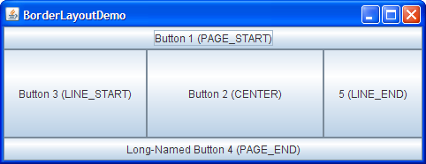
BorderLayout….

Slide 26
GridLayout
The GridLayout Class in the java.awt Package.
This layout manager can be used to stack component from top to bottom or left to right.
The GridLayout manager must be created with two arguments to its constructor:
The number of rows in grid and
The number of columns
Ex. GridLayout gr1=new GridLayout (10, 3);
Ex. GridLayout gr2=new GridLayout (10, 3, 5, 8);
row column Horizontal vertical gap gap
Note:- Default gap between Component is 0 pixel in both vertical and horizontal direction.

Slide 27
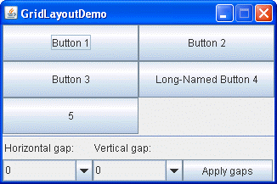

Slide 28
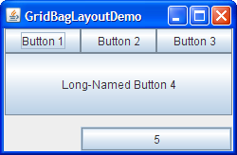
GridBagLayout

Slide 29
CardLayout
The CardLayout Class in the javax.swing Package.
This layout differ from the other Layout because they hide some component from the view.
The most common method to use card layout is to use a panel for each card. Components are added to the panel first, and then the panel are added to the container that is set to use card layout.
setLayout(new CardLayout());
After set a container to use the card layout manager ,we use add() method call to add cards to the layout.
Syntax:- add(component, String)
Ex. JPanel, Jbutton etc. Name of the CARD (this can be any thing)

Slide 30
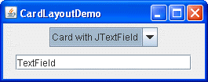
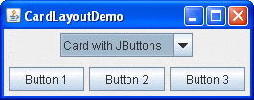

Slide 31
BoxLayout:-
The BoxLayout Class in the javax.swing Package.
This layout manager can be used to stack component from top to bottom or left to right.
The BoxLayout manager must be created with two arguments to its constructor:
Container it will manage.
Class variables
X_AXIS (for left-to-right)
Y_AXIS (for top-to-bottom)
Ex:BoxLayout bl=new BoxLayout (new JPanel, BoxLayout.X_AXIS);

Slide 32
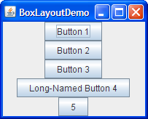

Slide 33
Example of Border Layout
Example of Grid Layout

Slide 34
Event Handling

Slide 35
What is Event?
GUI components like button, List, Checkbox etc. communicate with the rest of the applications through events.
The source of an event is the component that causes that event to occur.
The listener of an event is an object that receives the event and processes it appropriately.

Slide 36
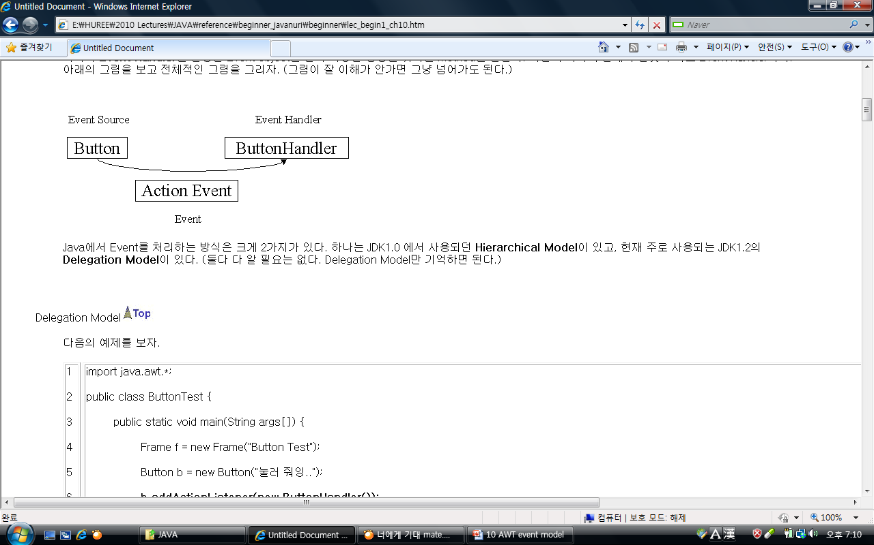
Event Delegation Model
Event
Actions like clicking button with a mouse, pushing down a key on keyboard
Event Source
Sources that cause events such as a button, a key
Event Handler
Methods that get an occurred event, then handle proper actions

Slide 37
Event classes
EventObjcet | FocusEvent
AWTEvent | ItemEvent
ActionEvent | KeyEvent
AdjustmentEvent | MouseEvent
ComponentEvent | MouseWheelEvent
ContainerEvent | TextEvent
WindowEvent

Slide 38
AWTEvent class
Subclass of EventObjcet class and member of java.awt package
Super class of all AWT events handled by event delegation model
Methods:
int getID(): returns type of event in integer, for ex 1001 for button
String toString()

Slide 39
Event Class | Description | Listener Interface
ActionEvent | generated when button is pressed, menu-item is selected, list-item is double clicked | ActionListener
MouseEvent | generated when mouse is dragged, moved,clicked,pressed or released also when the enters or exit a component | MouseListener
KeyEvent | generated when input is received from keyboard | KeyListener
ItemEvent | generated when check-box or list item is clicked | ItemListener
TextEvent | generated when value of textarea or textfield is changed | TextListener

Slide 40
Event | Description | Listener
WindowEvent | generated when window is activated, deactivated, deiconified, iconified, opened or closed | WindowListener
ComponentEvent | generated when component is hidden, moved, resized or set visible | ComponentEventListener
ContainerEvent | generated when component is added or removed from container | ContainerListener
AdjustmentEvent | generated when scroll bar is manipulated | AdjustmentListener
FocusEvent | generated when component gains or loses keyboard focus | FocusListener

Slide 41
ActionEvent & ActionListener
Action event is probably the easiest and most common event handlers to implement.
Constructors of ActionEvent:
ActionEvent( Object Source, int type, String command)
ActionEvent( Object Source, int type, String command, int modifiers)
Methods of ActionEvent:
String getActionCommand()
int getModifiers()
Method of ActionListener
void actionPerformed(ActionEvent obj)
Example

Slide 42
ItemEvent & ItemListener
Generated when a checkbox or list item is clicked
Constructor:
ItemEvent(Item source, int type, int state)
Constants:
SELECTED
DESELECTED
ITEM_STATE_CHANGED
This class implements method:
void itemStateChanged(ItemEvent obj)
Example

Slide 43
MouseEvent & MouseListener
Constants:
MOUSE_CLICKED
MOUSE_PRESSED
MOUSE_RELEASED
MOUSE_DRAGGED
MOUSE_ENTERED
MOUSE_EXITED
MOUSE_MOVED
Methods:
getX( ),getY( ), getClickCount( )
Example

Slide 44
MouseListener & MouseMotionListener
Methods of MouseListener
void mouseClicked(MouseEvent obj)
void mousePressed(MouseEvent obj)
void mouseReleased(MouseEvent obj)
void mouseEntered(MouseEvent obj)
void mouseExited(MouseEvent obj)
Methods of MouseMotionListener
void mouseMoved(MouseEvent obj)
void mouseDragged(MouseEvent obj)

Slide 45
KeyEvent & KeyListener
Event is generated when key is pressed of the keyboard
Constant:
KEY_PRESSED
KEY_RELEASED
KEY_TYPED
Methods of KeyListener:
void keyPressed(KeyEvent obj)
void keyReleased(KeyEvent obj)
void keyTyped(KeyEvent obj)
Example

Slide 46
FocusEvent & FocusListener
Generated component gets or lost focus.
Constants:
FOCUS_GAINED
FOCUS_LOST
Listener methods:
void focusGained(FocusEvent e)
void focusLost(FocusEvent e)
Example

Slide 47
TextEvent & TextListener
Generated when user inputs text into TextField or TextArea
Constants:
TEXT_VALUE_CHANGED
Listener method:
void textValueChanged(TextEvent e)
Example

Slide 48
WindowEvent & WindowListener
Handles events related to window
Constants:
WINDOW_ACTIVATED
WINDOW_DEACTIVATED
WINDOW_CLOSING
WINDOW_CLOSED
WINDOW_OPENED
WINDOW_GAINED_FOCUS
WINDOW_LOST_FOCUS
WINDOW_ICONIFIED (Minimize)
WINDOW_DEICONIFIED
WINDOW_STATE_CHANGED
Methods of listener is according to above constants
Example

Slide 49
Adapter Classes
Java adapter classes provide the default implementation of listener interfaces.
If you inherit the adapter class, you will not be forced to provide the implementation of all the methods of listener interfaces.
Adapter class | Listener interface
WindowAdapter | WindowListener
KeyAdapter | KeyListener
MouseAdapter | MouseListener
MouseMotionAdapter | MouseMotionListener
FocusAdapter | FocusListener

Slide 50


